Slide 1

Application of EventMapper framework for Coronavirus Detection [LITMUS]
Neha Pande
Date 04/12/2020

Slide 2
Motivation
Global statistics
1800000+ cases confirmed, 100000+ deaths, 210+ countries affected
Serious outbreaks in Mainland China, US, Spain, South Korea, Italy, Germany, Iran
Declared as pandemic by WHO
Can be spread by symptomless people
More contagious and higher transmission rate compared to SARS or MERS
No vaccine available

Slide 3
Data Sources
Two Types
Probabilistic sources
Corroborative sources (high confidence sources)
Why Probabilistic sources?
Good source for real-time data
Mainly social media sources
Global coverage
Example: Twitter, Facebook
Why Corroborative sources?
Only probabilistic sources are insufficient
Less noise
High accuracy
Fine-tuning the ML model
Example: News Articles, Historical databases and reporting agencies

Slide 4
Data Sources and Technologies
Kaggle Dataset on Novel Corona Virus 2019 [Link] (Corroborative)
Day-wise timeseries data at global level
3 files : Confirmed cases, Recovered cases, Deaths
Important fields : Id, Province, Country, Day-wise cases
Original source : John Hopkins
Update frequency : 2 days
Twitter data stream (Probabilistic)
Complete size is ~5GB
Important attributes extracted : created_at, id, id_str, text, source, retweeted, retweet_count, timestamp_ms, lang, geo, coordinates, place, follower_count, quote_count, reply_count, favorited, retweeted
Technologies
Database : MySQL
Python libraries : pandas, json, pickle, keras, tensorflow, numpy, nltk
Web Framework : Flask
User Interface Design: HTML, CSS, JavaScript, Twitter Bootstrap

Slide 5
Twitter and Kaggle data
Twitter Keywords
["2019-ncov", "2019ncov", "Chinesepneumonia", "corona", "coronavirus", "covid19", "covid2019", "epidemic", "hubei virus", "infected pneumonia", "mers-cov", "ncov", "novel coronavirus", "outbreak", "pheic", "quaratine", "sars", "sars-cov-2", "world health organization", "wuhan"]
Tweet Example
{ "created_at": "Sat Feb 29 18:59:56 +0000 2020", "id": 1233829273691049984,"text": "Coronavirus will spread in California, health officials say: 'It's already out of the bag' https:\/\/t.co\/YHBt1myH5X #uncategorized #feedly … }
Kaggle Example
Province/State, Country/Region, Lat, Long, 1/22/20, 1/23/20, 1/24/20, 1/25/20 …
Beijing, Mainland China, 40.1824, 116.4142, 14, 22, 36, 41…

Slide 6
Heterogeneous Data Integration Phase
Fetching required data (Kaggle and Twitter)
Selected Kaggle (corroborative) source
Downloaded data using Kaggle API
Identified event keywords for Twitter
Populating MySQL
MySQL scripts to create tables in MySQL
Cleaned, parsed and added Kaggle data to MySQL
Integrating both data sources
Parsed and obtained tweets with important attributes
Combined data from tweets and Kaggle records : Location and time attributes
Calculated weights of the tweets using attributes : favorited, retweeted, reply count, quote count
Stored the labelled tweets and not labelled tweets separately in MySQL

Slide 7
User Interface & MySQL Integration Phase
Designed User Interface for the system
Integrated it with backend MySQL
Functionalities implemented
Search by province displays markers and current coronavirus data for different provinces
Clear, Delete and Show markers for each event
Display country-wise timeseries data

Slide 8
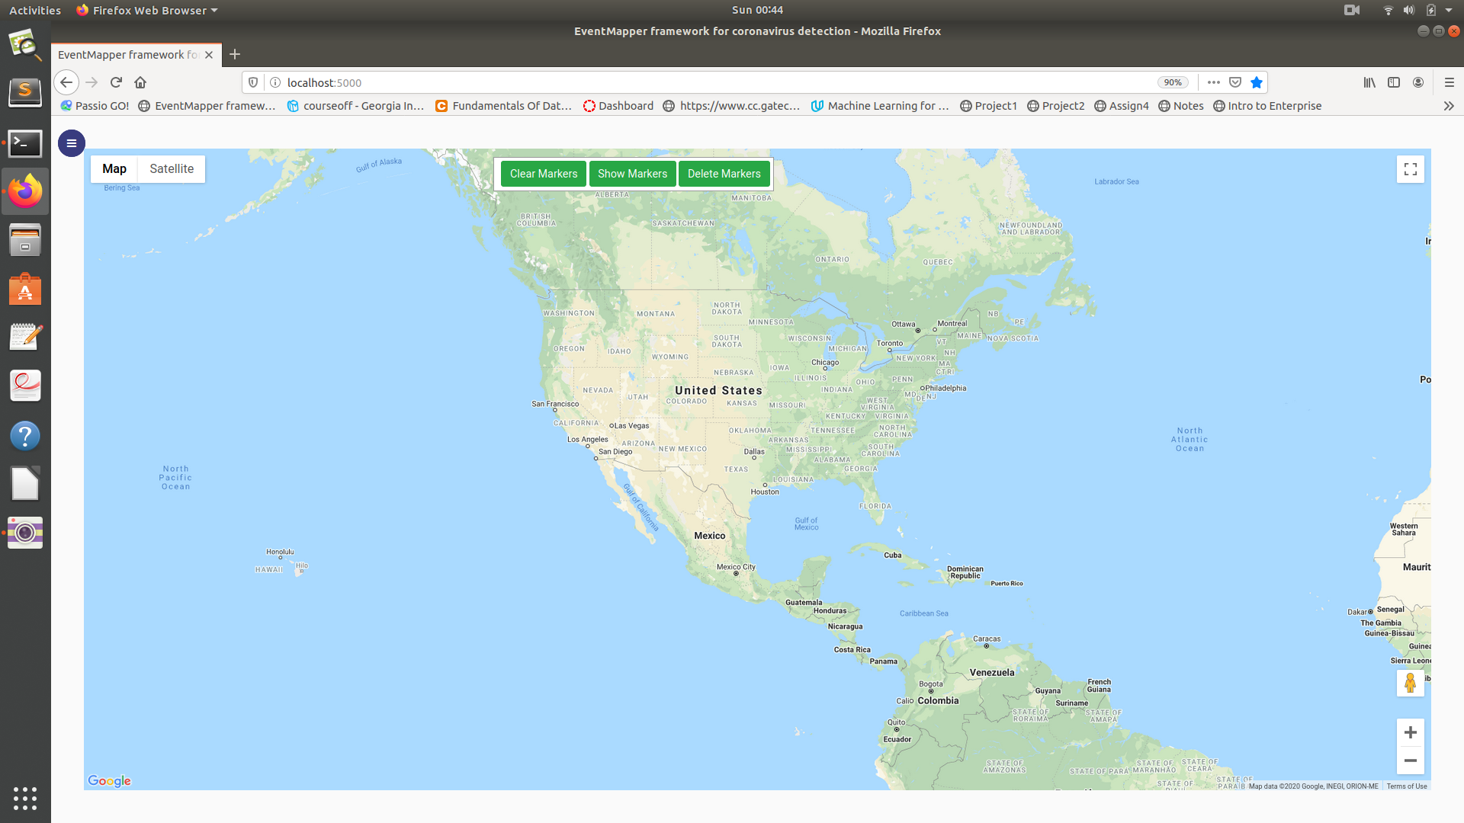
Initial landing page (UI)

Slide 9
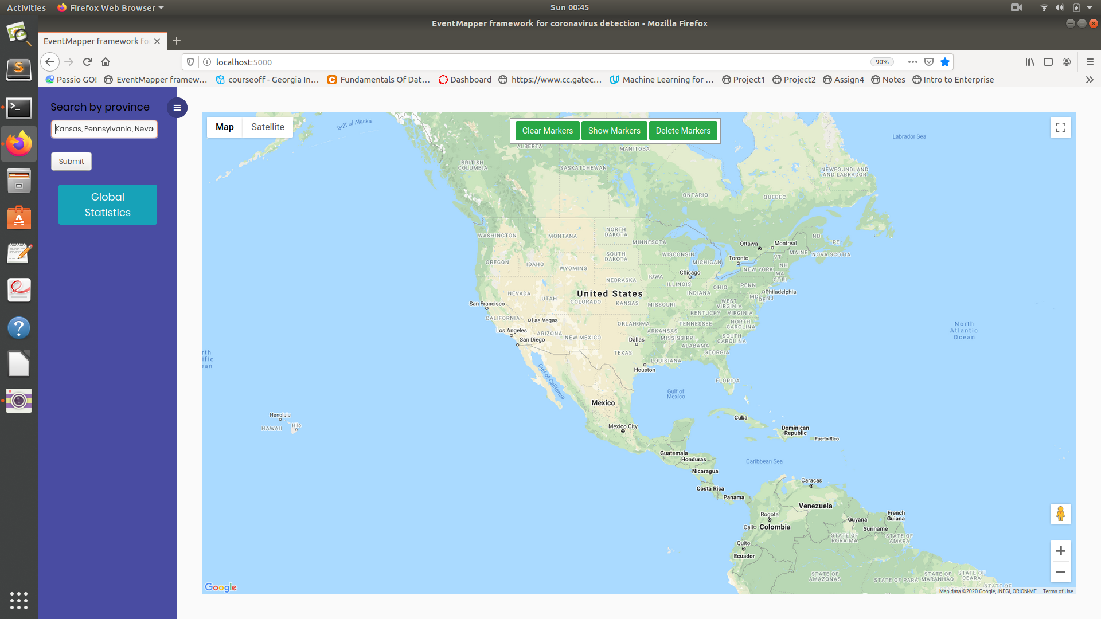
Search by Province (Side Panel)

Slide 10

Search by Province Results

Slide 11
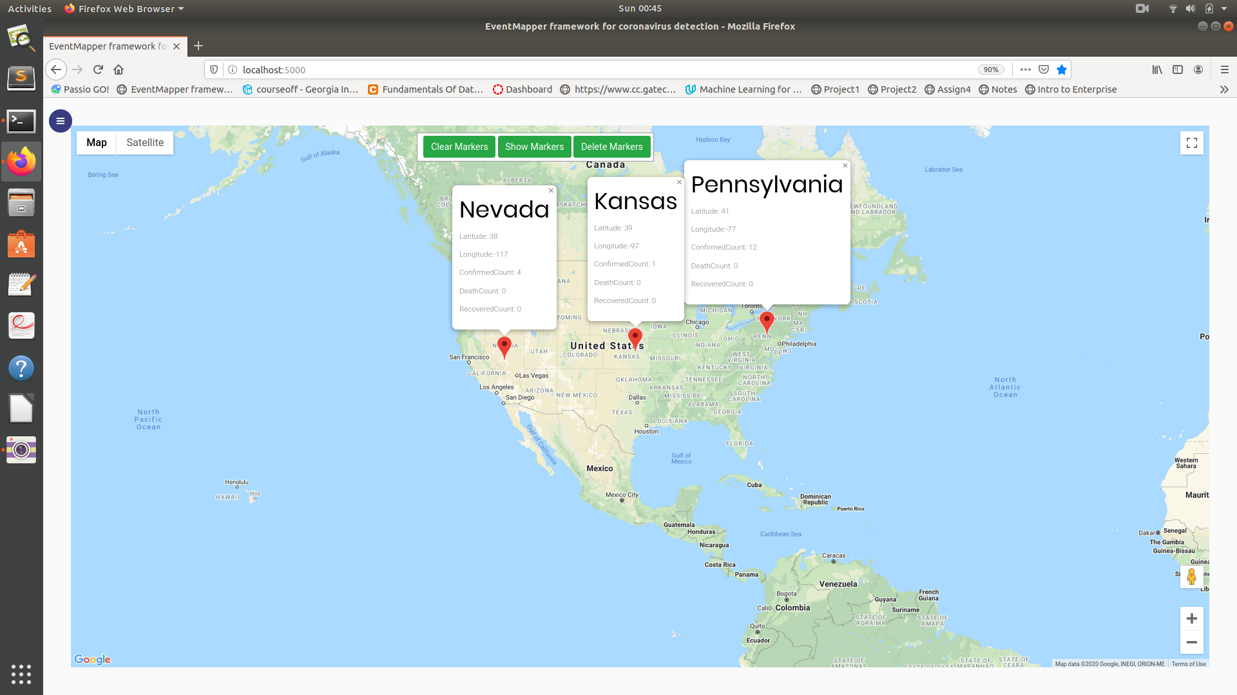
Event Information for each province (on click)

Slide 12
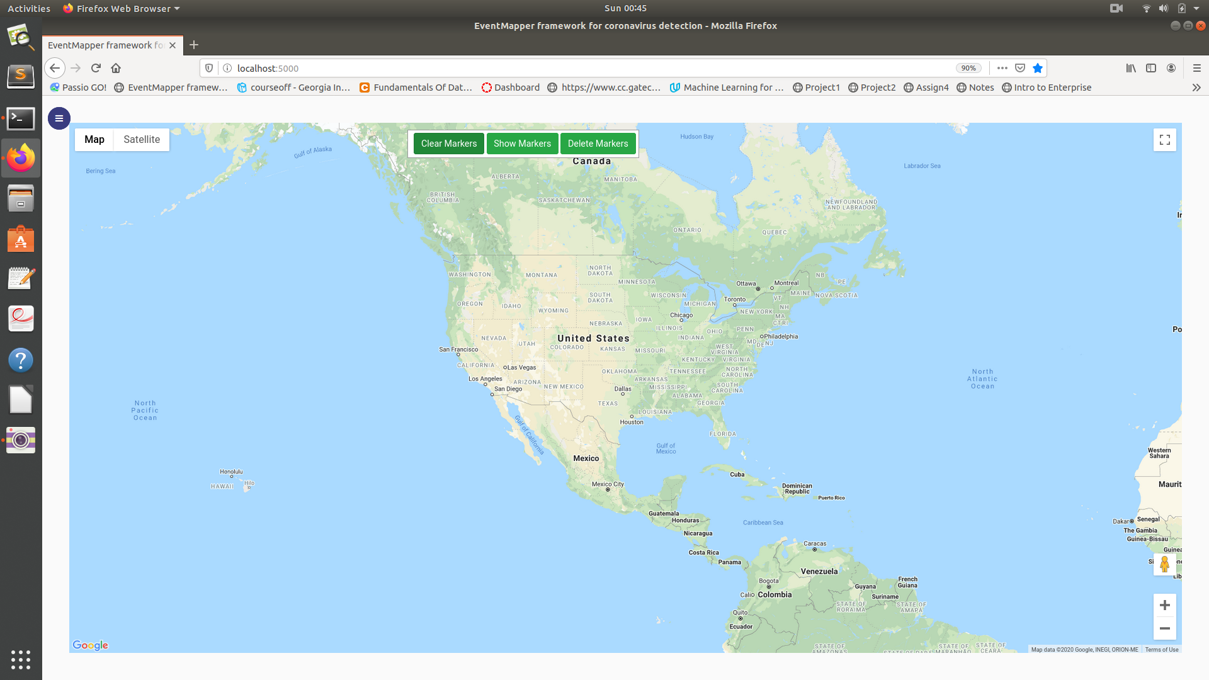
Clear Markers (on click)

Slide 13

Show Markers (on click)

Slide 14

Delete Markers (on click)

Slide 15
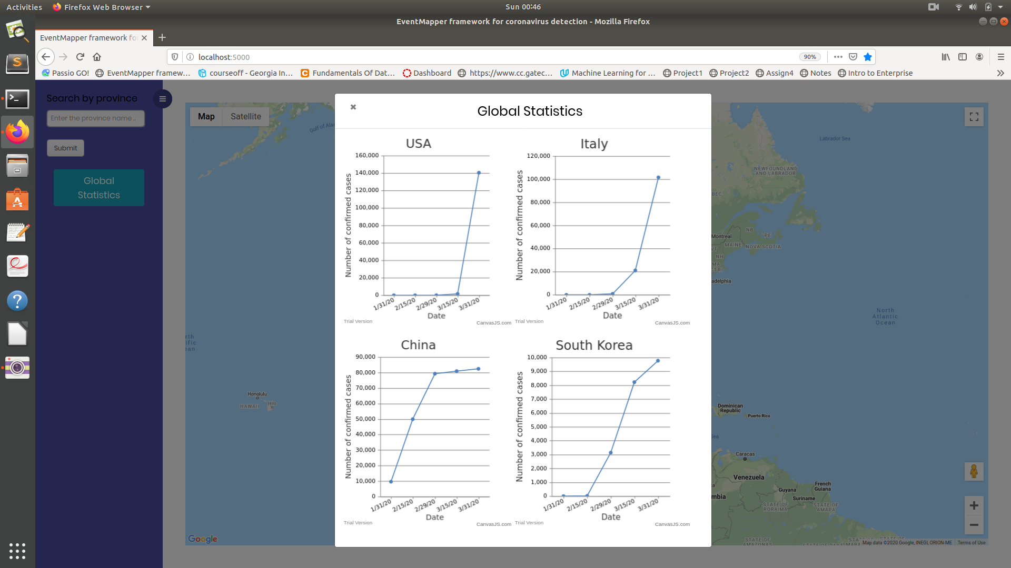
View Global trends

Slide 16
ML Classifiers Phase
Pre-trained ML model
Sequential 3 layer neural net with keras/tf
Trained using the labelled tweets and saved
Sentence to vector model
Clean the tweets by converting the encoding
Loaded word2vec model
Sentence2vec:
Found value in the word2vec model for each token in the tweet
Create a sentence2vector model by averaging the sum of all word embeddings by taking the average of each contiguous word for every bigram word embedding
Predicting the class using pre-trained ML Model
Manually labelled data (insufficient labels)
Loaded and used pre-trained ML model to predict the class

Slide 17
Challenges
Change in data format (Kaggle). Old data format has province names but the new data format uses zipcodes
Errors in location fields (province, country) in Kaggle source. For example, spelling mistakes, use of abbreviations, missing fields in data etc.
Tried using fasttext vectors but found the model very expensive to load
Used word2vec model and averaged continuous words since sentence2vec was also very expensive to load
Building classifiers for event detection

Slide 18
References
Suprem, Abhijit & Pu, Calton. (2020). EventMapper: Detecting Real-World Physical Events Using Corroborative and Probabilistic Sources
Suprem, Abhijit & Pu, Calton. (2019). Event Detection in Noisy Streaming Data with Combination of Corroborative and Probabilistic Sources
CDC Coronavirus https://www.cdc.gov/coronavirus/2019-ncov/index.html [Online]
WHO Situation Reports https://www.who.int/emergencies/diseases/novel-coronavirus-2019/situation-reports/ [Online]
Keras Model/Tensor flow https://www.dlology.com/blog/how-to-convert-trained-keras-model-to-tensorflow-and-make-prediction/ [Online]
Keras https://keras.io/applications/ [Online]

Slide 19
Thank You! Demo [Link]

